Slide 1
Assessment and migration of SQL Server to Azure
Notes:
IMPORTANT NOTE:
Microsoft Ready will utilize Windows 10 and the new PowerPoint 2016, as well as PowerPoint 2013 on all event machines. Please build your slides utilizing the appropriate Template and utilize the version of PowerPoint that works best.
Windows 10 devices now connect remotely through VPN using the PIN with Passport for Work. Speakers needing to use VPN in a demo, will need to have registered for Phone Authentication at https://phoneregistration.microsoft.com. Additional details are also available here: https://microsoft.sharepoint.com/sites/itweb/securelogon/Pages/FAQ.aspx

Slide 2
Azure Database Migration Service Accelerate your journey to the cloud
Near-zero
downtime
Migrate at scale
Optimize IT infrastructure
Azure Database Migration Service (Azure DMS)
A seamless, end-to-end solution for moving on-premises SQL Server, Oracle, and other relational databases to the cloud.
Near-zero downtime for your business critical apps*
Scale from multiple sources to your target database
Free up time and resources that can go toward transforming your business
*Feature will be made available close to service’s GA

Slide 3
Near-zero downtime migration service
SQL
Business critical apps have near-zero downtime during a highly resilient migration

Slide 4
Migration lifecycle Microsoft tools to accelerate your journey to the cloud during the migration lifecycle
Azure Database Migration Service (Azure DMS)
SQL Server Migration Assistant (SSMA)
Data Migration Assistant (DMA)
Database Experimentation Assistant (DEA)
Remediate applications
Functional & performance tests
Discover
Assess
Convert
Data Sync
Cutover
Migrate data, schema & objects
Data Migration Assistant (DMA)
SQL Server Migration Assistant (SSMA)
Optimize
Azure Database Migration Service (Azure DMS)
Near-zero downtime enabled by 3rd party tools

Slide 5
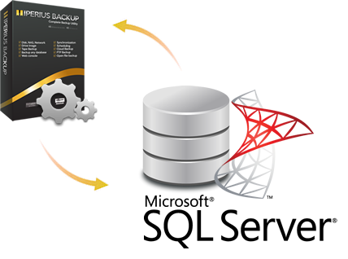
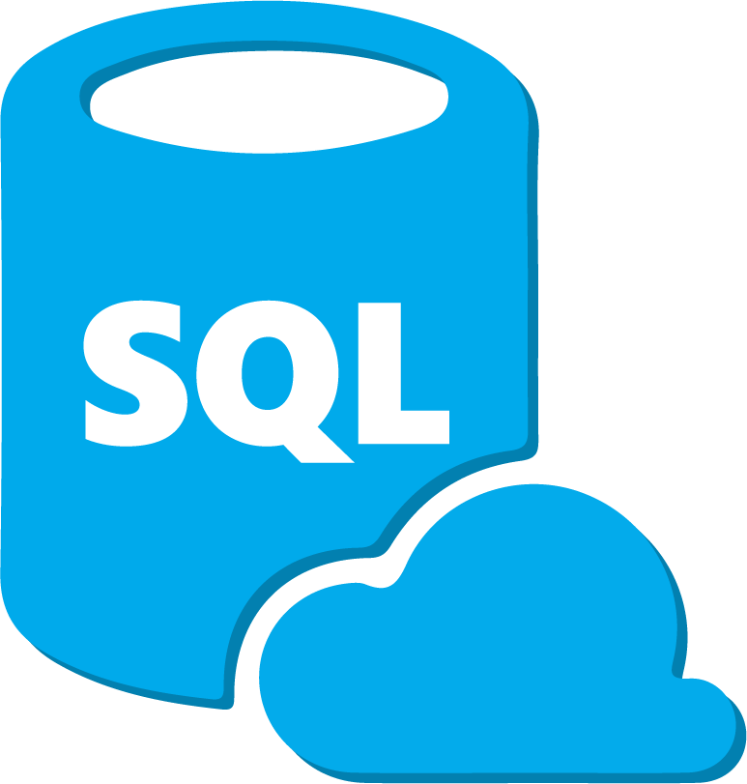




SQL Upgrade and Conversion Tools
Upgrade
DMA+DEA
Windows Azure
Conversion
SSMA
Windows Azure

Slide 6
Azure Database Migration Service (DMS) Comprehensive Database Migration Service
Fully managed database migration service for operational databases, data warehouses, and NoSQL databases
From On-premises, Private Clouds, and Public Clouds
Homogeneous and heterogeneous source-target pairs
Minimal downtime migrations
Current focus: Reliability and performance Iterative addition of source-target pairs Continued investment in friction-free migrations
Note: For more information, see https://azure.microsoft.com/en-us/campaigns/database-migration/.
Reliable and seamless migrations to Azure

Slide 7
DMS – Conceptual Model

Slide 8


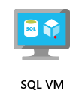
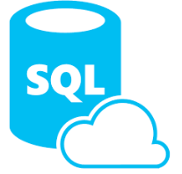

Database Migration Assistant (DMA) SQL to SQL Migrations
1. Assess and identify issues
3. Migrate schema, data, and logins
DMA
Legacy SQL Server Instance
2. Fix issues

Slide 9

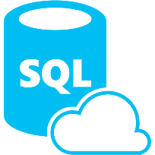

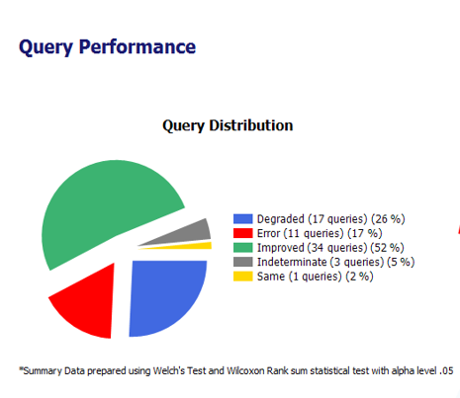
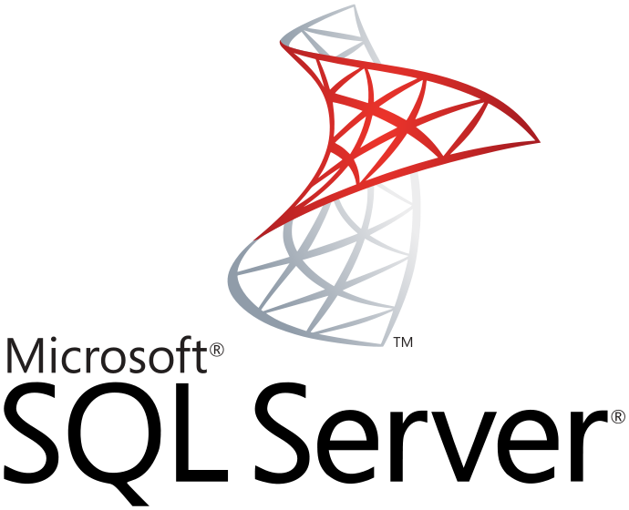
Database Experimentation Assistant (DEA) SQL to SQL A/B testing
Target 1
SQL 2008 Instance
Statistical analysis
Comparison reports
Extensive tracing
On-premises SQL 2008 instance
Replay Workloads
capture prod workload
Analyze results
Target 2
SQL 2014 Instance
Extensive tracing
Capture
Replay
Analyze
Compare

Slide 10
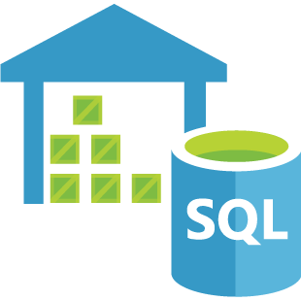




SQL Server Migration Assistant (SSMA) <other> to SQL Migrations
SQL Server | SQL VM | Azure SQL Database | Azure SQL Data Warehouse

Slide 11
Azure Data Migration Process Overview

Slide 12
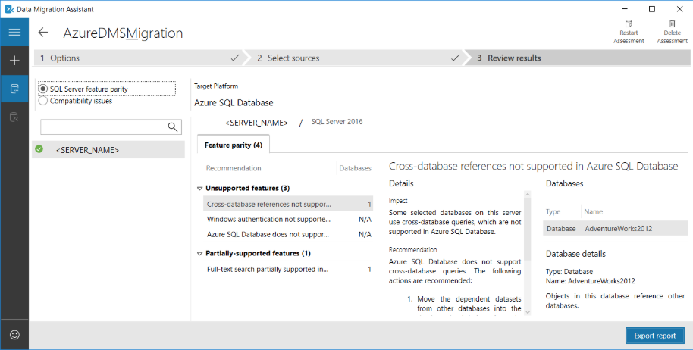
Database Assessment

Slide 13
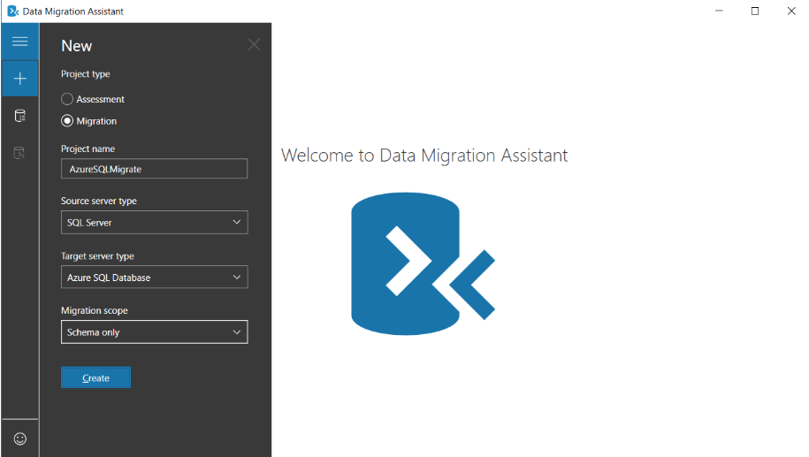
Database Migration Assistant (DMA)-Defining Scope

Slide 14
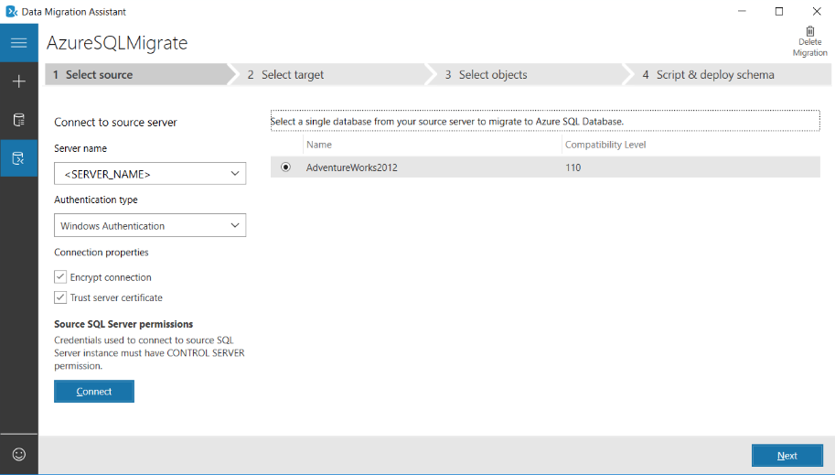
Database Migration Assistant (DMA)

Slide 15
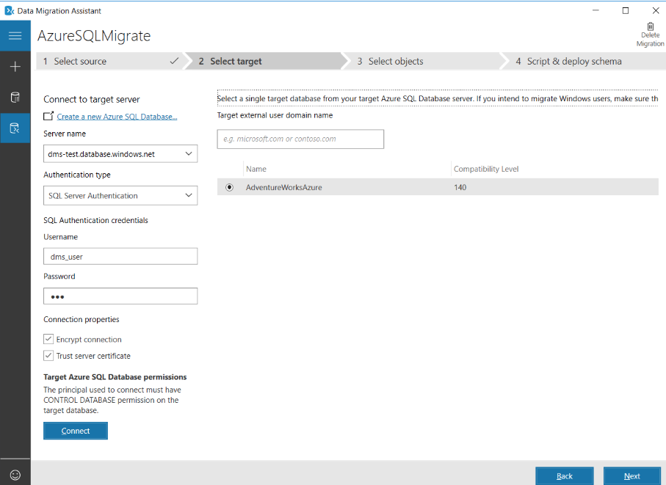
Database Migration Assistant (DMA)

Slide 16
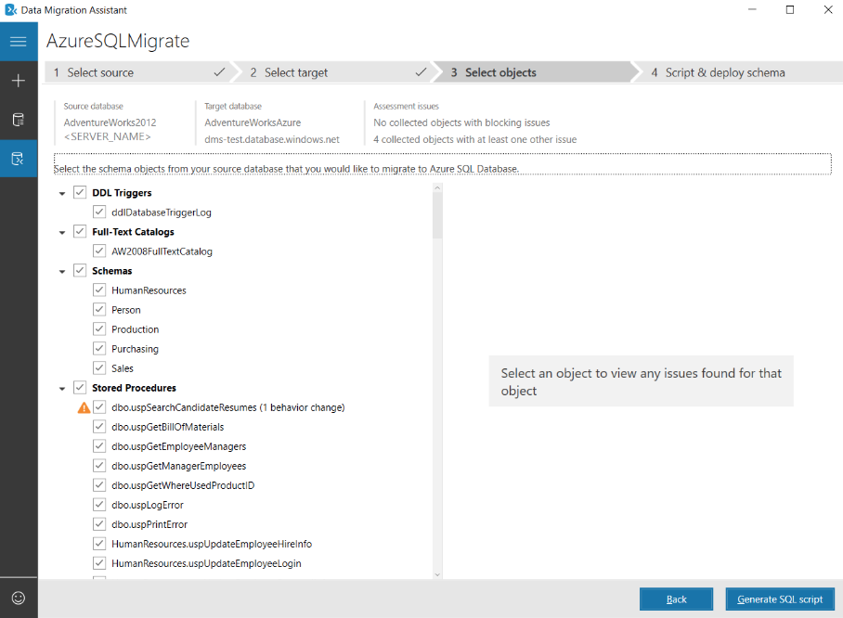
Database Migration Assistant (DMA)

Slide 17
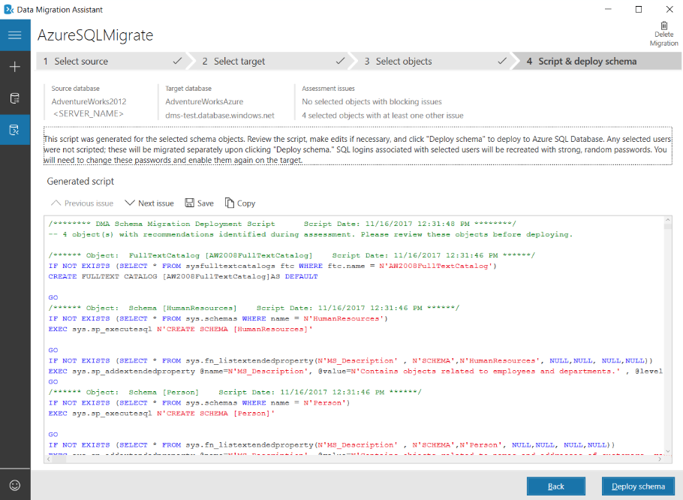
Database Migration Assistant (DMA)

Slide 18
Database Migration Assistant (DMA)

